Slide 1
Ranked Choice Voting: Adding variety to the voting booth
By Andy Hudson

Slide 2
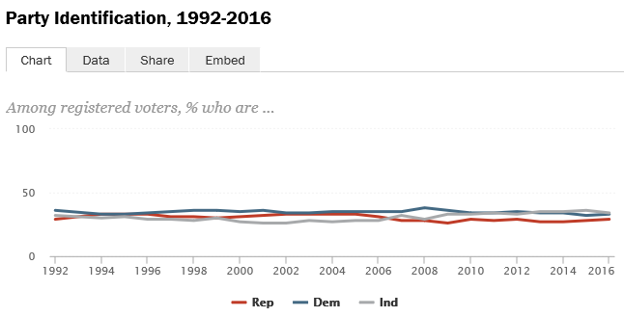
Party Identification
(5)

Slide 3
Party Representation in Congress

Slide 4
Federal Party Representation
America:
Democrats
Republicans
Independent
Australia:
Liberal Party of Australia
Independent
Katter’s Australian Party
Australian Labor Party
The Nationals
Australian Greens
Nick Xenophon Team
Pauline Hanson’s One Nation
Liberal Democratic Party
Derryn Hinch’s Justice Party
Country Liberal Party
Australian Conservatives

Slide 5
1992 Presidential Election

Slide 6
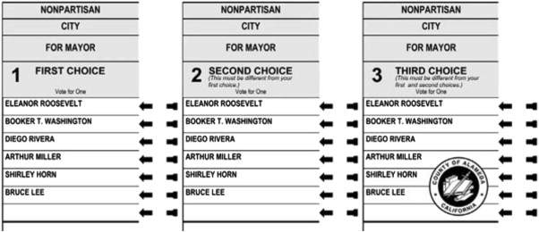
Ranked Choice Sample Ballot
(8)

Slide 7
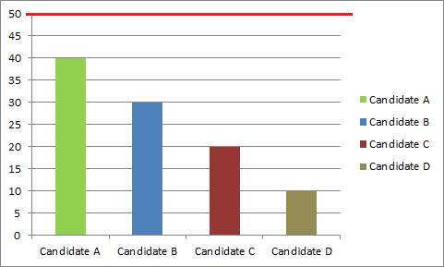
How Are Votes Tallied?
(Round 1)

Slide 8
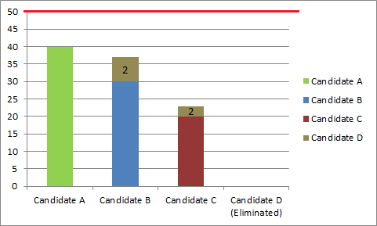
How Are Votes Tallied?
(Round 2)

Slide 9
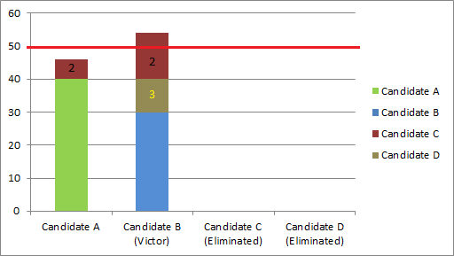
How Are Votes Tallied?
(Round 3)

Slide 10
Ranked Choice Sample Ballot
(8)

